Slide 1

MOTION-BASED SMART
LIGHT SYSTEM
PRESENTED BY AKSHAT PORWAL

Slide 2

INTRODUCTION
Motion-Based Smart Light System is an energy-efficient automation setup that uses motion sensors (like PIR sensors) to detect human movement and automatically turn lights on or off. When motion is detected, the light turns on; if no movement is sensed for a set time, the light turns off. This system is commonly used in smart homes, offices, and public spaces to save electricity and enhance convenience.

Slide 3
Ardruino Uno
PIR Sensor
Buzzer
LED
Resistor
LCD (For Display)
COMPONENTS
REQUIRED

Slide 4
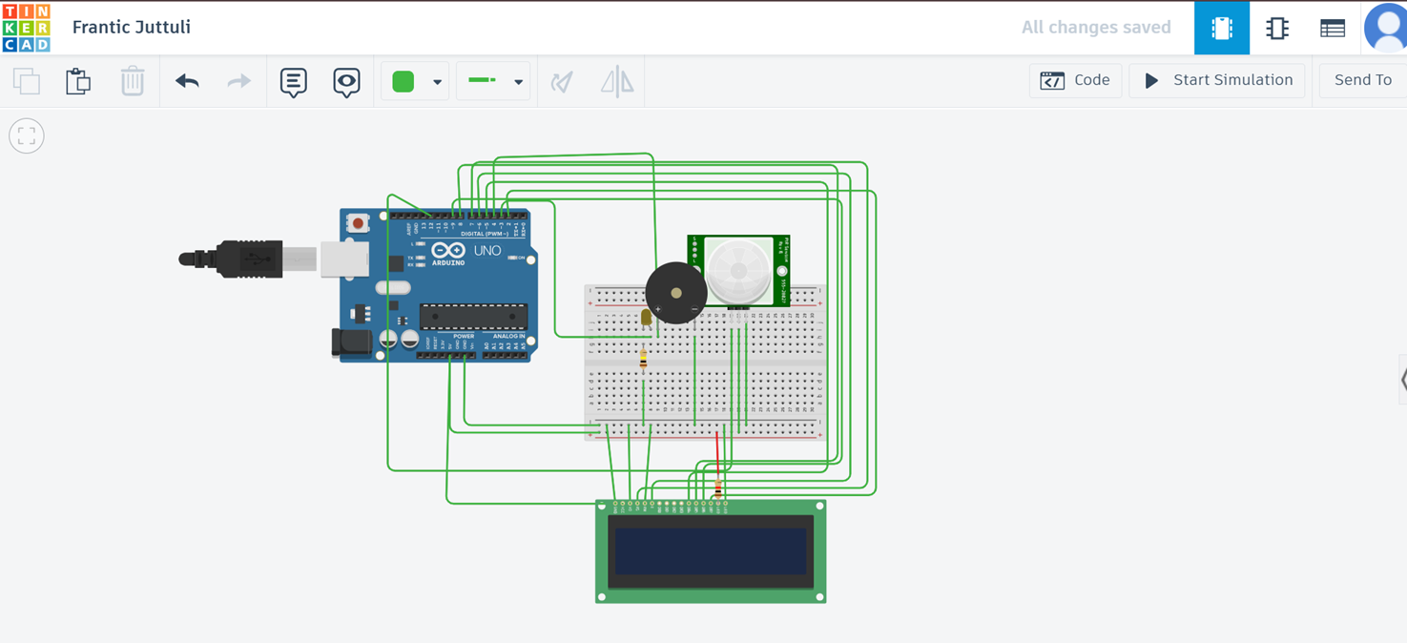
CIRCUIT DIAGRAM

Slide 5
WORKING PRINCIPLE
The system operates using a PIR (Passive Infrared) sensor, which detects infrared radiation (heat) emitted by moving objects like humans. When motion is detected:
The PIR sensor sends a signal to the microcontroller (e.g., Arduino).
The microcontroller processes the signal and activates a relay or directly powers an LED/light
If no motion is detected for a specific duration, the microcontroller turns the light off.

Slide 6
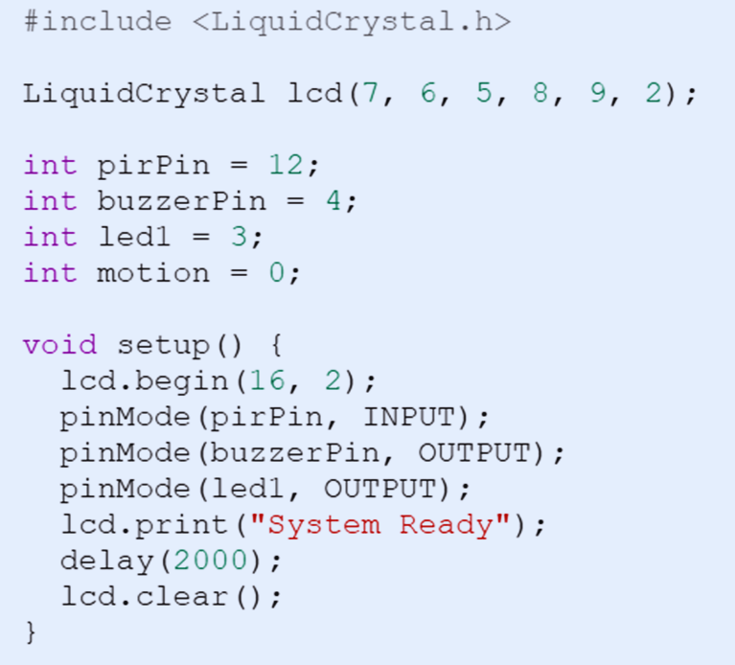
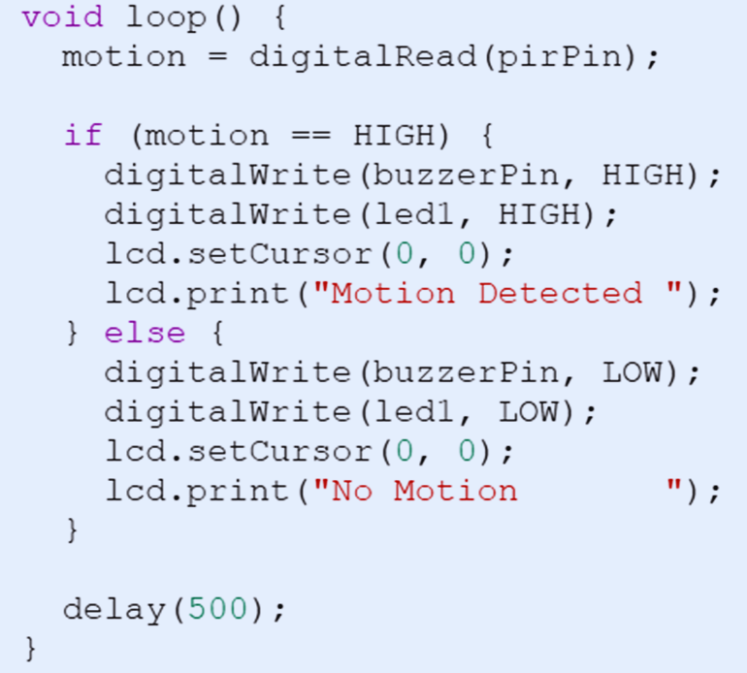
ARDUINO CODE

Slide 7
APPLICATIONS
Automatically lights up rooms, hallways, or bathrooms when motion is detected, enhancing convenience and saving energy.
Ensures lights turn on only when rooms or conference areas are in use, reducing electricity costs.
Lights and ventilation turn on when someone enters, improving hygiene and energy efficiency.
Smart streetlights light up only when pedestrians or vehicles pass, conserving power in low-traffic areas.
Lights automatically adjust based on occupancy, maintaining focus and conserving energy.

Slide 8
CONCLUSION
The Motion-Based Smart Light System is a practical and energy-efficient solution widely used in homes, offices, public spaces, and industrial areas. By automatically controlling lighting based on human presence, it enhances convenience, reduces electricity consumption, and contributes to smart, sustainable living. Its simplicity, effectiveness, and adaptability make it an essential component in modern automation and IoT-based systems

Slide 9
Thank you very much!

